Slide 1





Meteorite Landings
Bryan LoLordo, Coble Hartman,
Bri Ortega, Marcial de Leon Jr.,
Michelle Anne Verger, Shawn Shojaei

Slide 2


Input Files
Data: 34,513 rows of meteorite data from Meteorite_Landings.xml
Site: https://catalog.data.gov/dataset/meteorite-landings
Source: NASA
Notes:
Meteorite landing from data.gov that was supplied by nasa, the global history of meteor landings, mass, location, name and group of it, what it was composed of

Slide 3

Key Pieces
01
02
03
04
05
Cleaning
Databases
Tables
Python - Jupyter Notebook
PostgreSQL
Raspberry Pi
Meteorite Data
Visualizations
APIs
Leaflet Heat Map
Plotly
Open Street Map
D3.js
SQLAlchemy - Flask

Slide 4
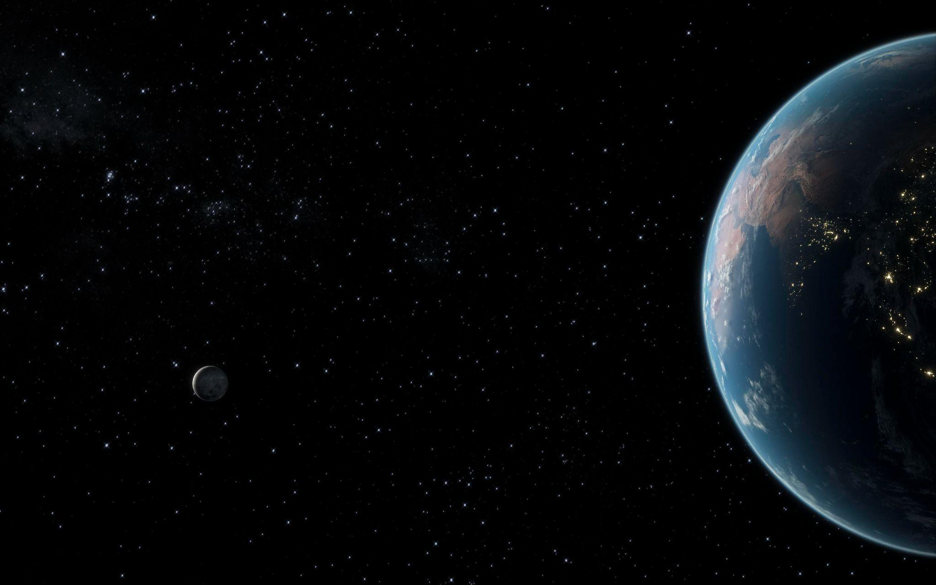
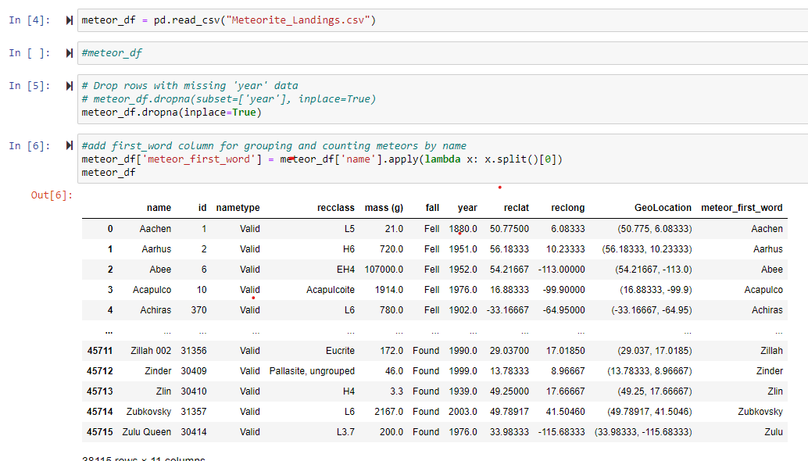
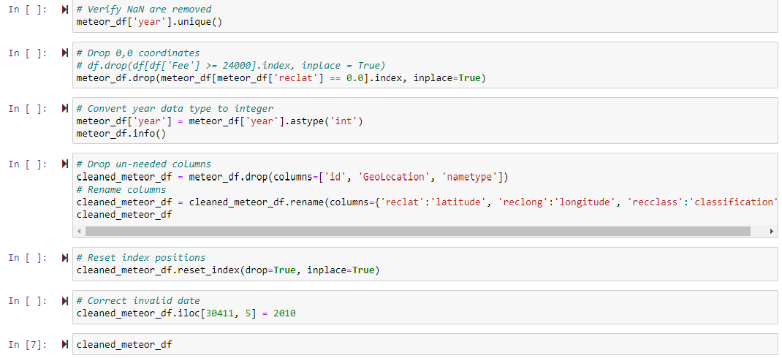
Data Cleaning
in Jupyter Notebook
Dropped rows with missing year
Added first word column to group dataset by meteor name
Dropped invalid coordinates and dates
Got rid of unnecessary columns and renamed existing columns
Notes:
Most of the work involved discovering errors and issues in the data set. Data types were assigned. Entries without valid coordinate data were dropped. Unnecessary columns were dropped. Column headers were renamed for ease of loading into database. Invalid dates were corrected or dropped. Cleaned data was then exported to CSV.

Slide 5

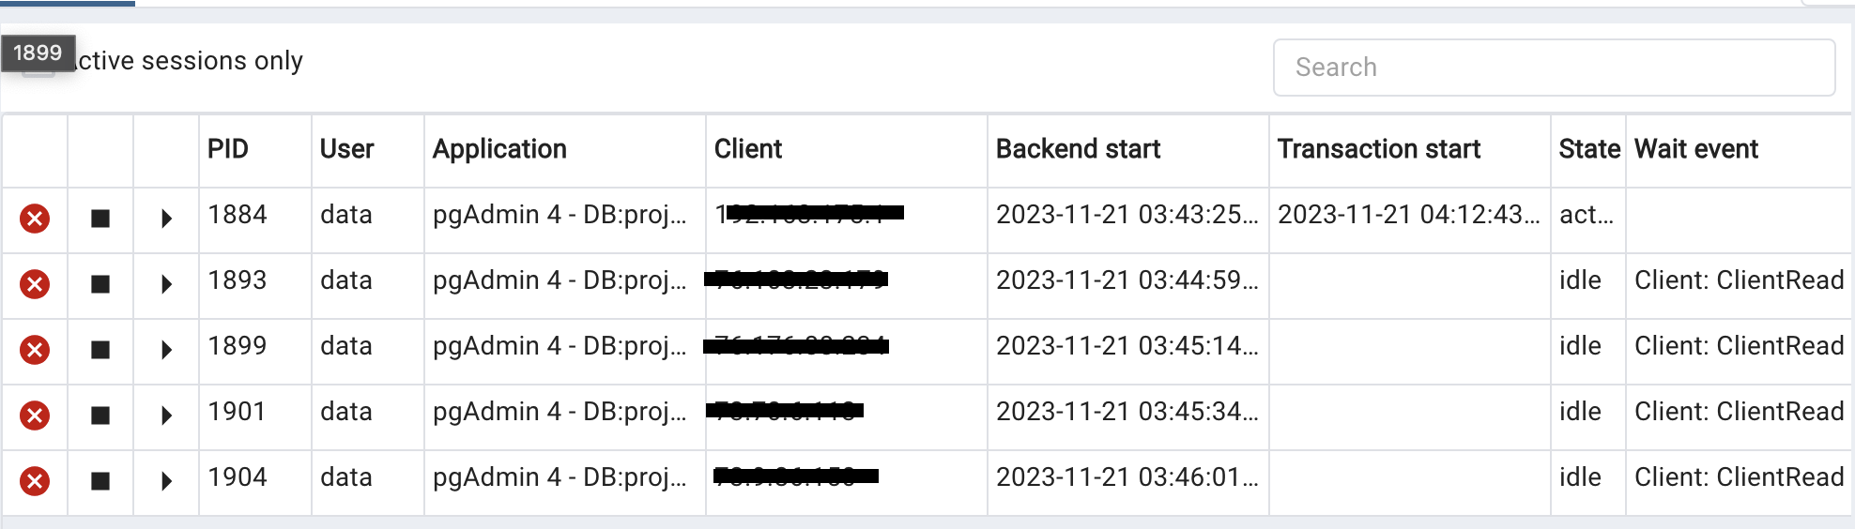




Raspberry Pi
Created and hosted a PostgreSQL server using Linux on a Raspberry Pi
Provided all team members with access to meteorite database

Slide 6


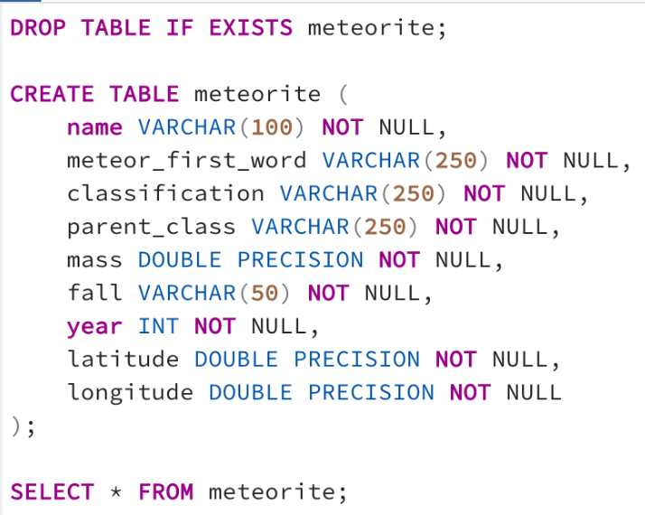
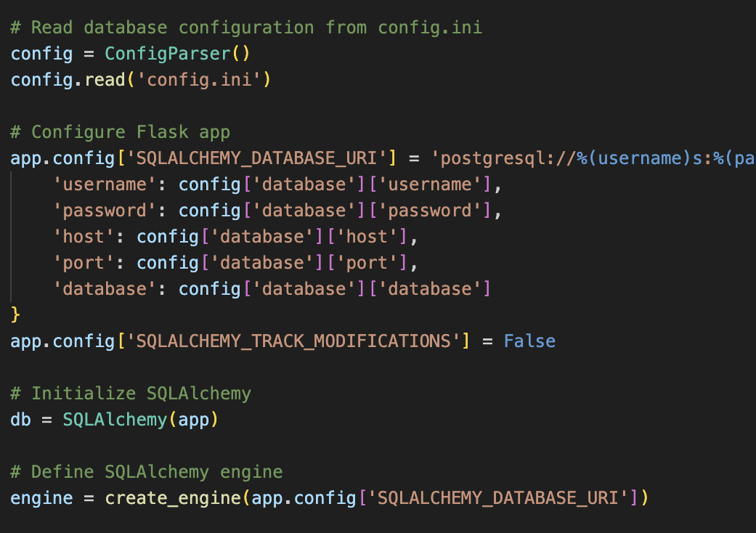
Uploaded with SQLAlchemy
Database in PostgreSQL

Slide 7
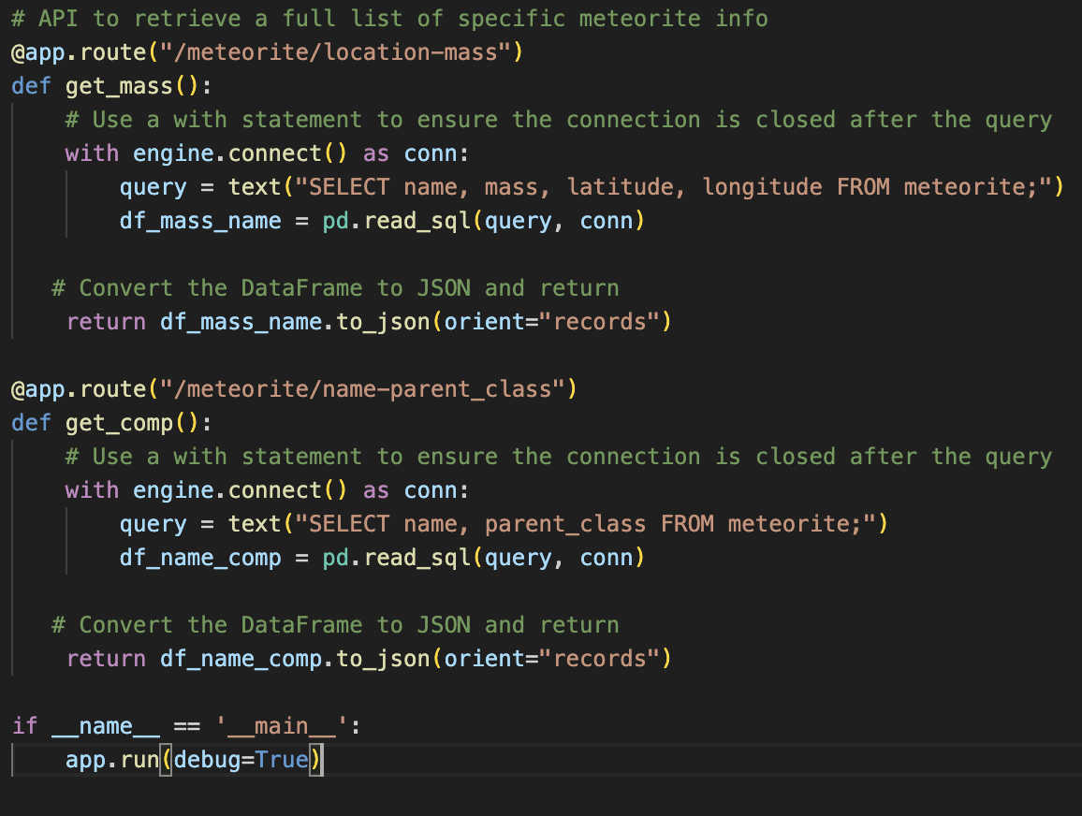
API using Flask

Slide 8
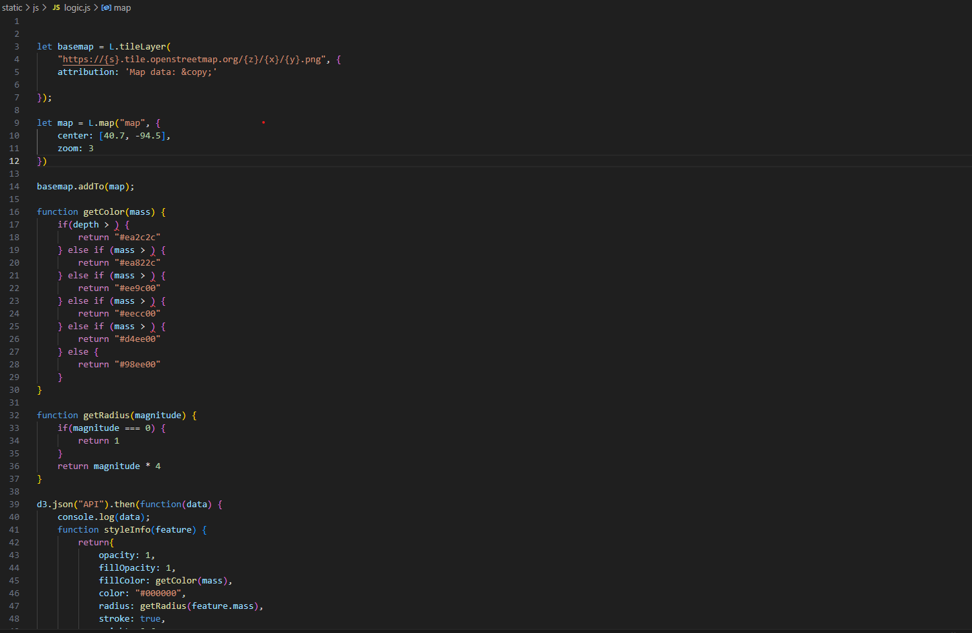
Visualizations
This tool maps and graphs meteorite data in three ways:
A locational map of meteorite landings
A bar chart that shows top 10 composition types
A “Drew” chart that shows the top 25 meteors by mass

Slide 9
The main types of meteorites
Each can be split into many more classes and types
depending on minerals, structure and chemistry
Iron
Stone
Stony-irons
Almost completely made of metal
(iron and nickel)
Mostly have silicate minerals
Have nearly equal amounts of metal and silicate minerals

Slide 10
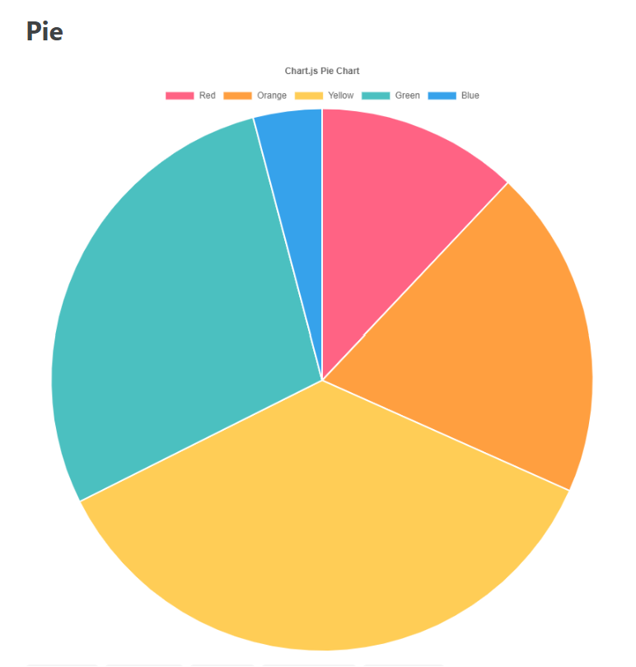
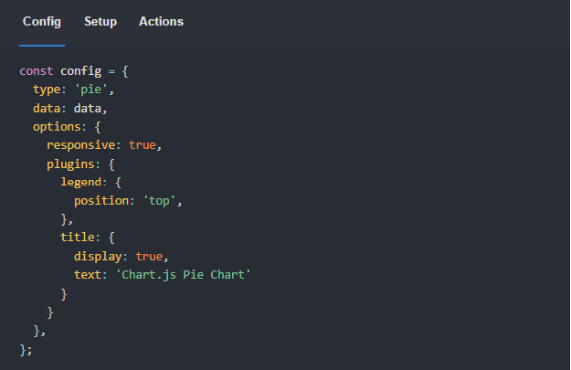
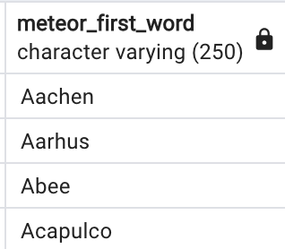
Future Considerations
Deeper Analysis: meteor_first_word
Postgres Formatting: formatted out special characters
Flask Deployment to AWS: everyone had access to API
Interactive Visualizations: Chart.js

Slide 11
THANK
YOU
—Jack London
“I would rather be ashes than dust!
I would rather that my spark should burn out in a brilliant blaze than it should be stifled by dry-rot.
I would rather be a superb meteor, every atom of me in magnificent glow, than a sleepy and permanent planet.
The function of man is to live, not to exist.
I shall not waste my days trying to prolong them.
I shall use my time.”

